Slide 1


JAVA SE
(Core java)
Lecture 1

Slide 2

Today’s Agenda
An Introduction to JAVA
Prerequisites Of Learning Java
Necessity Of Programming
What Is Java ?
What Is Platform Independence ?
Where Java Stands Today ?

Slide 3
Pre Requisites Of Learning Java
To start learning Java , you should be familiar with basics of programming
And since Java itself has been built up using C/C++ language so just basic knowledge in C/C++ is more than sufficient.

Slide 4
Why Do We Need Programming ?
To communicate with digital machines and make them work accordingly
Today in the programming world , we have more than 900 languages available.
And every language is designed to fulfill a particular kind of requirement

Slide 5
Brief History Of Prog. Lang
C language was primarily designed to develop “System Softwares” like Operating Systems, Device Drivers etc .
To remove design problems with “C” language , C++ language was designed.

Slide 6
Brief History Of Prog. Lang
It is an Object Oriented Language which provides data security and can be used to solve real world problems.
Many popular softwares like Adobe Acrobat , Winamp Media Player, Internet Explorer, Mozilla Firefox etc were designed in C++
Courtsey:http://www.stroustrup.com/applications.html

Slide 7
What is JAVA???...
JAVA is a Technology(not only a programming language) to develop Object oriented and Platform Independent applications.
Platform Independence
Technology

Slide 8
Platform Independence
PLATFORM
A Platform is the environment in which a program runs.
In simple terms it is combination of Operating system and Processor.
Example:- Windows+Intel(i5), Ubuntu+AMD
Operating System
Platform
Processor

Slide 9
How many physical machines are there in the figure ?
Answer:
12 Physical Machines
Windows (32 bit)
Mac
Linux
Windows(32 bit)
Windows (64 bit)
Linux
Mac
Linux
Windows (64 bit)
Linux
Windows(32 bit)
Mac

Slide 10
How many platforms are there in the figure ?
Answer:
Only 4
Windows (32 bit)
Mac
Linux
Windows(32 bit)
Windows (64 bit)
Linux
Mac
Linux
Windows (64 bit)
Linux
Windows(32 bit)
Mac

Slide 11
What makes Java platform Independent?
Program Execution in C/C++
Source Code
Compiler
Machine Code
Windows
Linux

Slide 12
Program Execution in JAVA
Source Code
Compiler
Byte Code
JVM
JVM
JVM
MacOS
Windows
Ubuntu

Slide 13
QUIZ 1
What does the JVM(Java Virtual Machine) do?
Compiles the Java Source Code
Generates bytecode
Converts bytecode to underlying machine’s instruction set.
Checks for error

Slide 14
QUIZ 2
The JVM for every platform is different
True
False

Slide 15
QUIZ 3
The bytecode generated by Java compiler for every platform is different
True
False

Slide 16
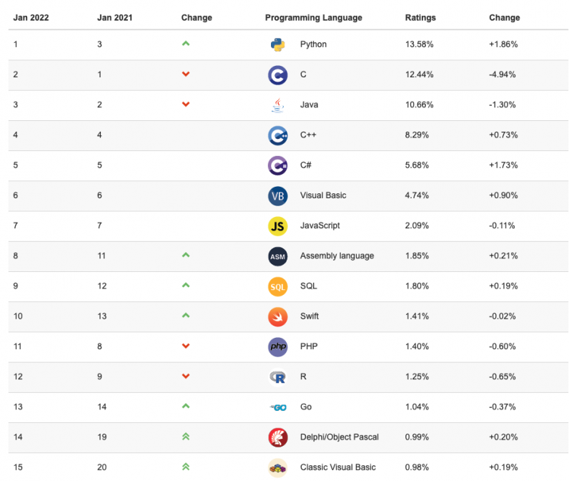
Where Java Stands Today ?
https://thenextweb.com/news/python-c-tiobe-programming-language-of-the-year-title-analysis

Slide 17
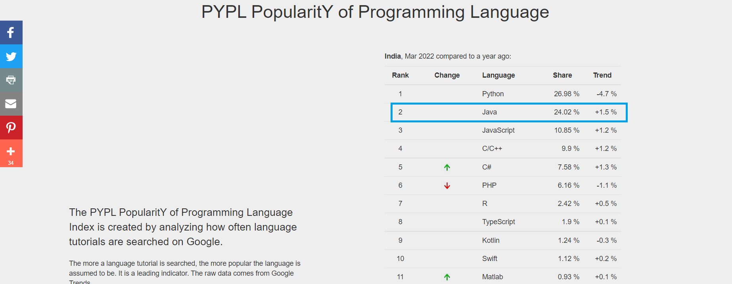
Java Openings Have Grown In India
https://pypl.github.io/PYPL.html?country=IN

Slide 18
Where Java Stands Today ?
To understand how Java has dominated the market from last 25 years , please see this video:
https://youtu.be/F-rk3U9SBs8

Slide 19
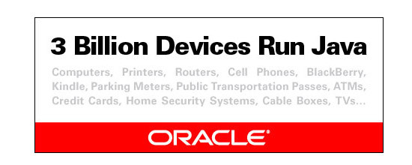
Where Java Stands Today ?
Do you know how many devices use Java ?
3 Billion devices run Java as per Oracle. (1 Billion= 100Crores)
1 Billion Java downloads per year.

Slide 20
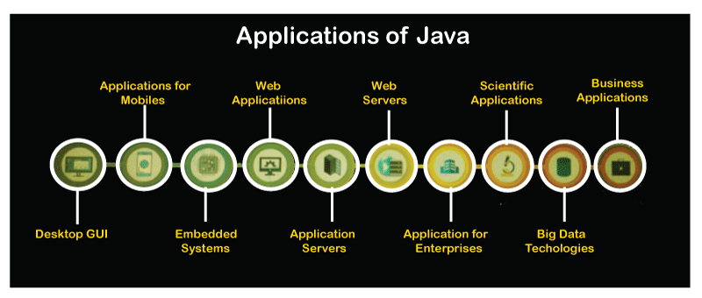
Types Of Java Applications

Slide 21
Course Outline
We will be covering complete Core Java in this course:
Finally all this will be incorporated in a PROJECT
Course Duration : Around 60 hours
Class Schedule: 7:30-8:30 PM on Tue,Thu,Sat
Module-1 | Module-2 | Module -3
Introduction | Introduction To OOP | Exception Handling
Properties | Static , Final | File Handling
Data Types | Inheritance & Polym | Collections
Operators | Interfaces | Multithreading ( In proj)
Control Statements | String Handling | Database Programming( In proj)
Arrays | Packages | GUI Programming( In proj)

Slide 22
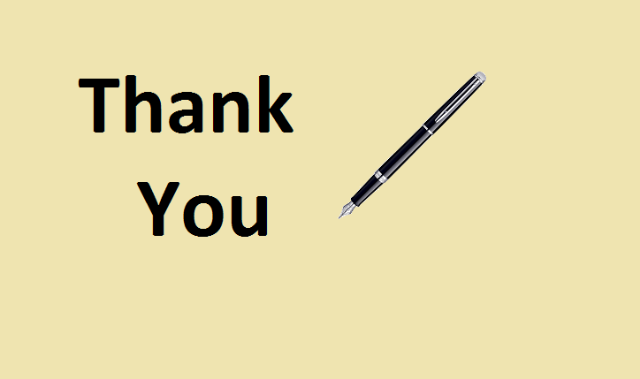
End Of Lecture 1
For any queries mail us @: scalive4u@gmail.com
Call us @ : 0755-4271659, 9826686245
Agenda for Second Lecture:
Editions Of Java
Difference between JDK,JRE and JVM
Downloading & Installing Java
Developing First Java Program

